Slide 1
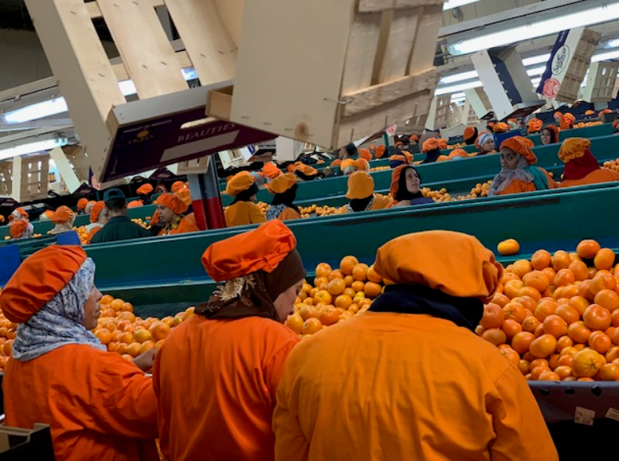
DIGITAL AGRICULTURE AND DISRUPTIVE TECHNOLOGY
A FUNDAMENTAL SHIFT
AGRICULUTRE GLOBAL PRACTICE-WORLD BANK
MARCH 2019

Slide 2
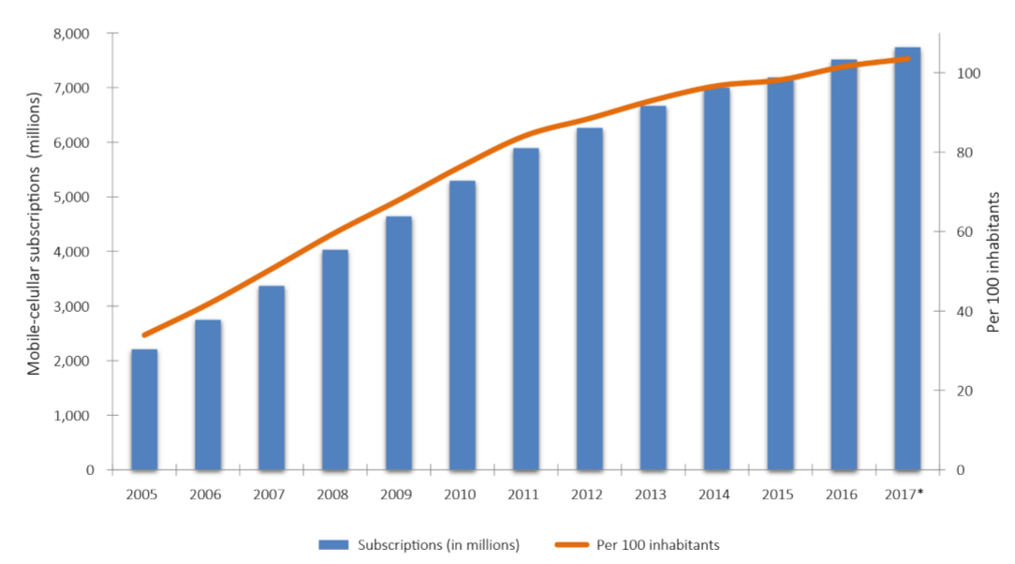
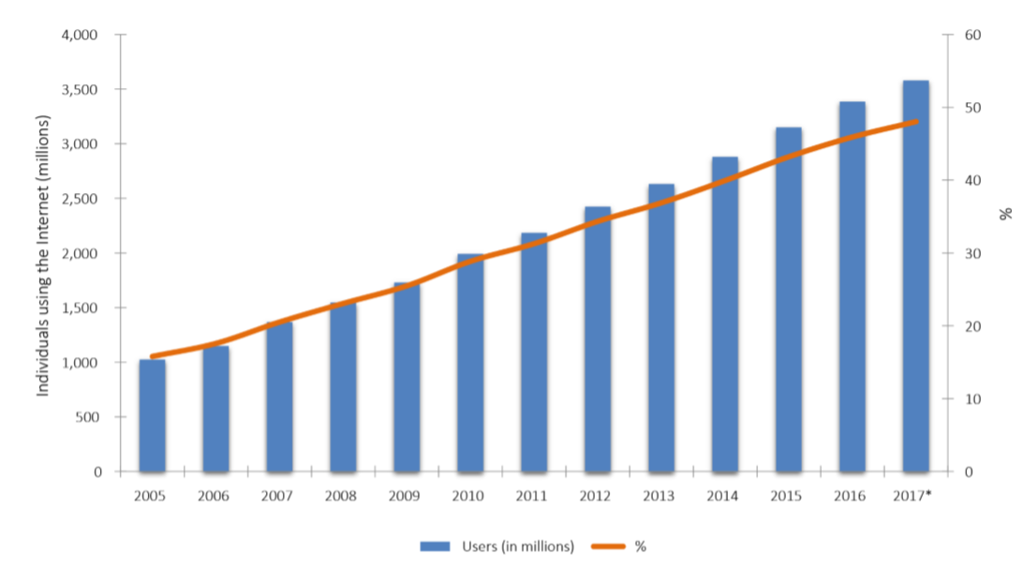
The Unprecedented Pace of Change
Booming cellular subscriptions and internet use globally

Slide 3
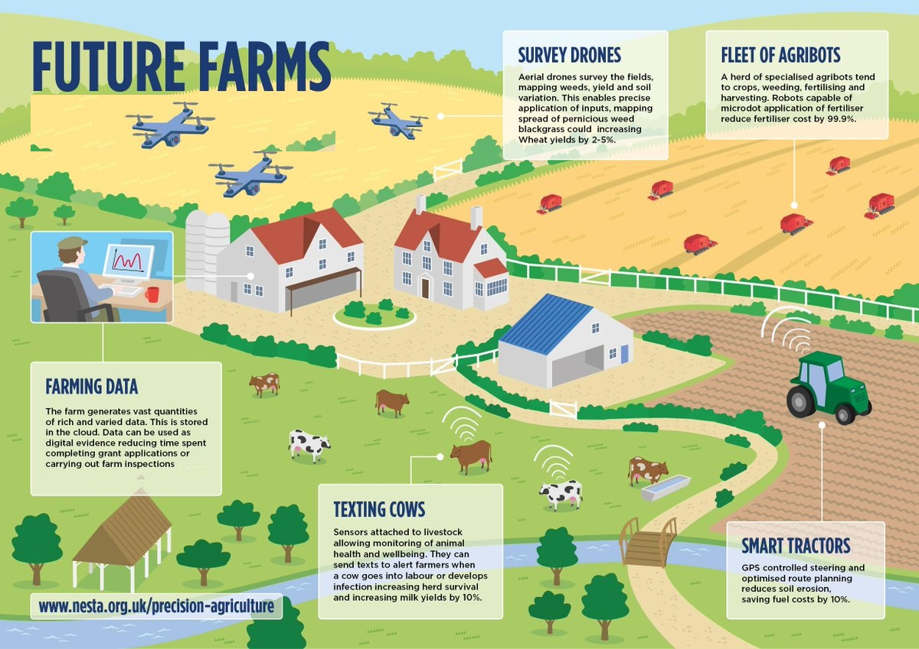
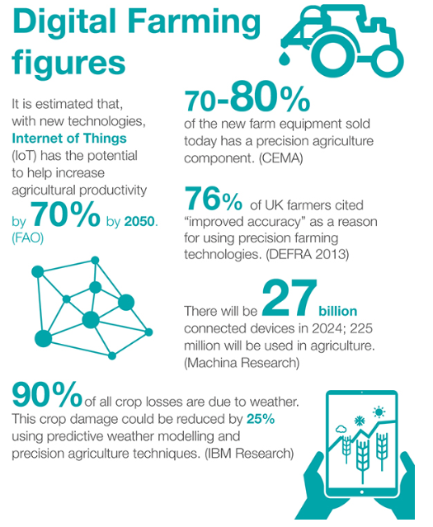
Opportunities from Deploying Advanced Technologies On Farm

Slide 4
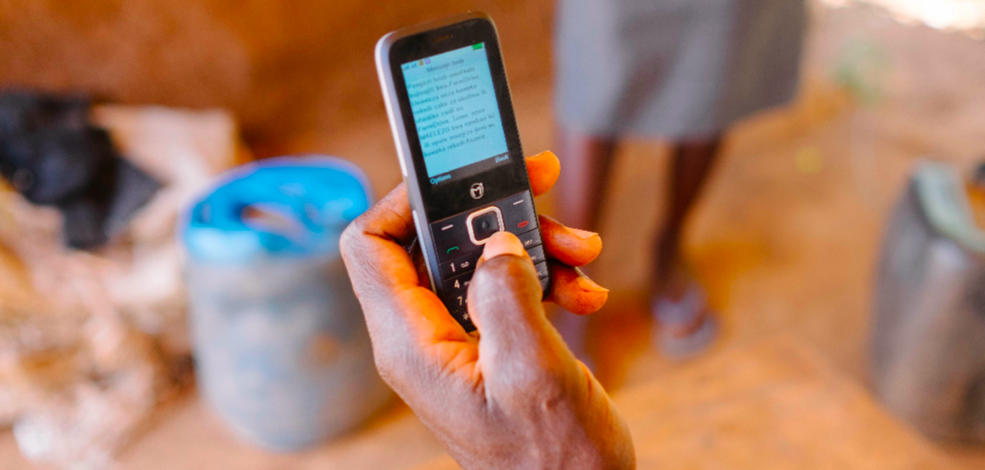
Disruptive Technologies in Agriculture
Weed-killing AI robot by ecoRobotix’s : can tell crops apart - have the potential to disrupt the multibillion dollar pesticides business. Solar-powered and can kill weeds for 12 hours straight without an operator at the helm. EcoRobotix uses 20 times less herbicide than traditional methods that spray entire fields.
iCow: A text message and voice-based mobile phone application for small-scale dairy farmers in Kenya. Developed to solve the problem of permanent access to verified agricultural content. The app prompts farmers on vital days of cows gestation period; helps farmers find the nearest vet and AI providers; collects and stores farmer milk and breeding records and sends farmers best dairy practices. In Kenya and Tanzania it is available in English and Kiswahili, in Ethiopia in Oromiffo, Amharic and Tigringnia.
FarmDrive: Connects smallholder farmers to loans and financial management tools through mobile phones. By keeping records of farmers’ expenses, revenues, and yields, FarmDrive derisks the farmers. Farmers can apply for a loan. Based on the farmers’ track record they can get loan approvals and receive loans via M-PESA. FarmDrive’s alternative credit scoring model based on individual, social, agronomic, environmental, economic and satellite data, ensures financial inclusion for the disenfranchised women that make up 60% of African smallholder farmers.

Slide 5
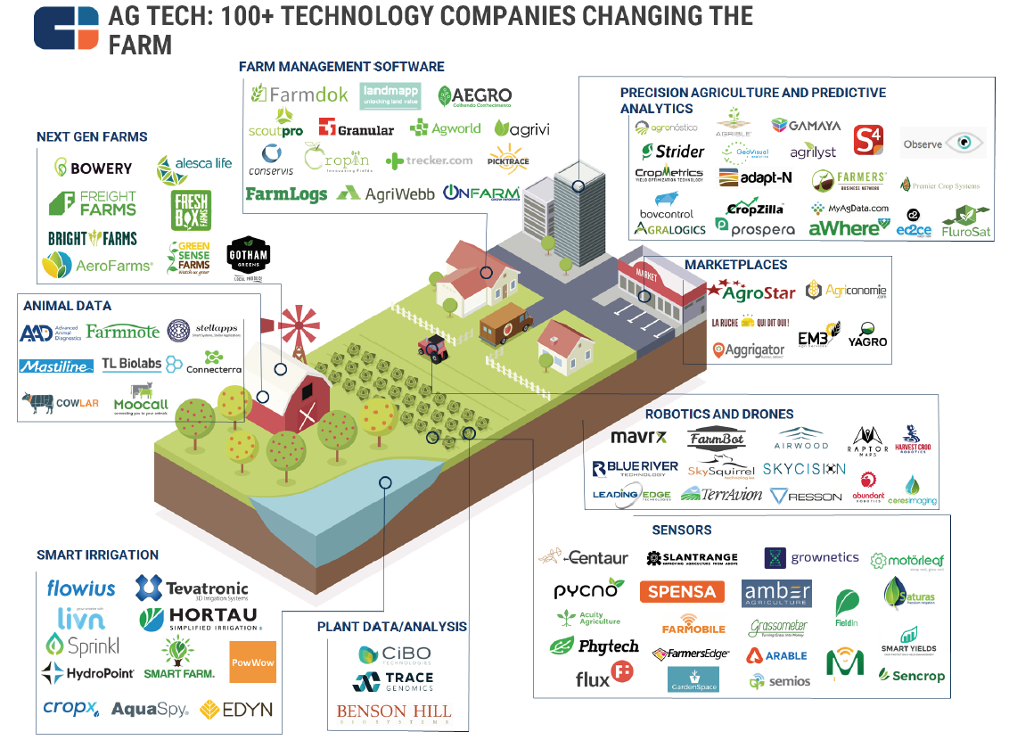
Digital Agricultural Technologies Can Transform the Sector
Priority areas for digital solutions in agriculture:
Agricultural Extension and Technology Transfer
Risk Management
Crop Production Forecasting
Environmental Land Use Monitoring

Slide 6
The demand, value chain linkages and production efficiency
Technology can solve a large part of today’s problems with the Food System internationally – McKinsey’s “Transformative Twelve”
Source: McKinsey & Company “Innovation with a Purpose: The role of technology innovation in accelerating food systems transformation.

Slide 7
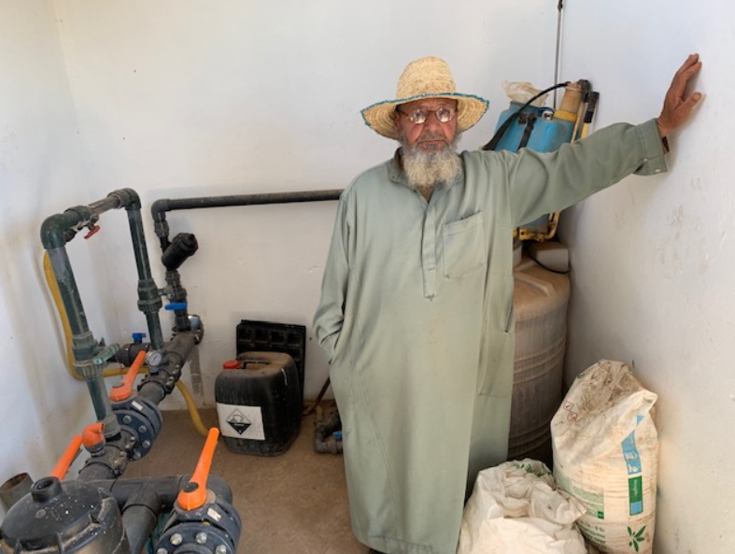
Examples from World Bank Projects

Slide 8
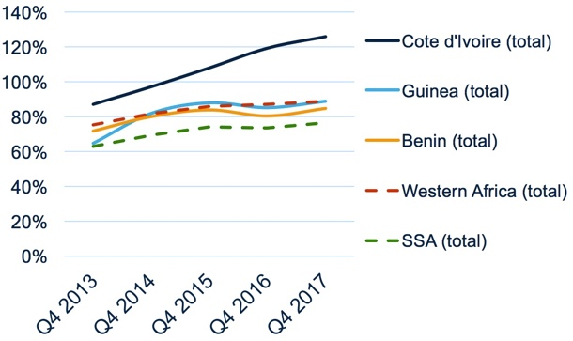
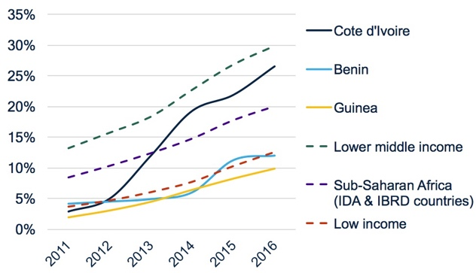
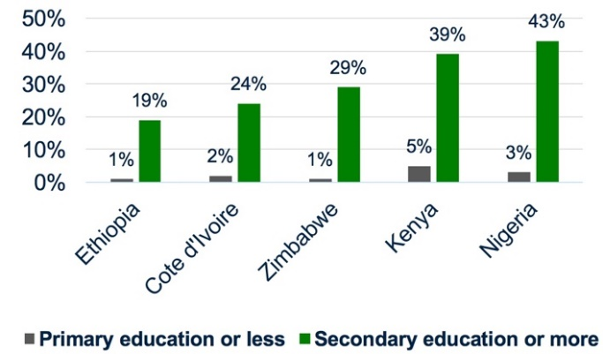
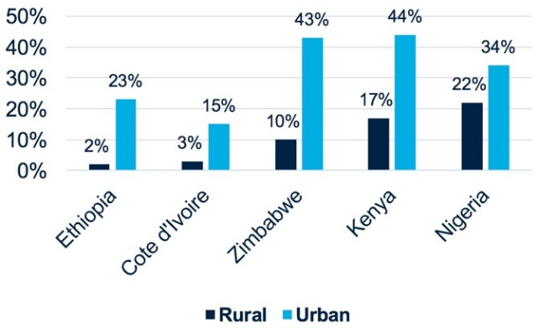
Cote d’Ivoire: Realizing Productivity Gains while Reducing Disparities
Evolution of mobile penetration (combined 2G and 3G, % population)
% of internet users (with averages for income grouping
of countries)
% of weekly internet use –
rural vs. urban population (2014)
% of weekly internet use –
different education levels (2014)
E-Agriculture Project
in Cote d’Ivoire:
Invest in ICT
infrastructure
to reduce gaps

Slide 9
The WBG Ag Observatory
Providing agricultural intelligence for the World Bank Group and Partners
Satellite Radar
Gamechanger Disruptive Technologies & Innovation?
“Big Data + Artificial Intelligence + Machine Learning”
Ground Weather Station
Ground Radar
Field
1.5 million Virtual Met Stations
Every 9 km across the terrestrial surface of the earth
7 billion data points updated every 6 hours

Slide 10
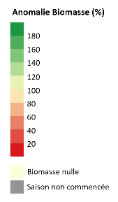
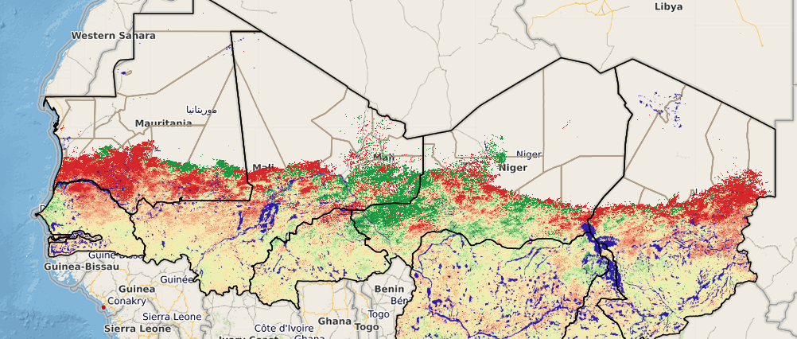
Biomass Collapse in the Sahel Threatens Livelihoods – Is there a mega drought in progress?
Biomass anomaly as of 30 September 2017 - NDVI analysis
Source: Sigsahel, 2017

Slide 11
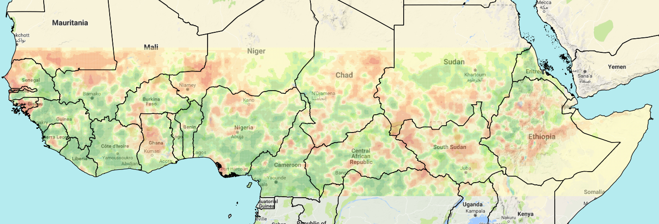
The actual situation (below) shows the extreme variability that is more and more the normal
Ag Observatory Real Time Analysis: No Mega Drought But Several Pocket Droughts
Pocket Drought: current rainfall far below normal
126.867 “Virtual Weather Stations” (VWS) –
Africa has less than 300 GWS that report to WMO (WBG, 2018)

Slide 12
Highlights of the year and our plans
Highlights in 2017-2018
Plans for 2018-2019
Digital Ag Tech Challenge Competitions in Kenya, Nigeria, Ethiopia and elsewhere
XL Africa Ag Tech Competition
Digital Innovation Platform and Fund in Kenya in support of a digital Ag Tech Start Up policy, and National Farm Digital Registry in Kenya
Mobilize Trust Fund resources for Digital Innovation Fund and Support Facility
Operational guidelines for structured learning for staff on disruptive and digital technologies
Dissemination of disruptive technologies through WB regional agriculture projects
Workshop with Singularity University on Disruptive Technologies in African Agriculture, including staff across WBG
Network of knowledge and learning with 45 key disruptive agricultural innovators, start ups and entrepreneurs across the region
In house Ag Observatory using satellite and other big data to provide real time advice to governments and take decisions on drought, climate shocks, pest incidence etc. Pilot in Kenya to launch a country pilot.

