Slide 1
CURRENT STATUS AND PROBLEMS AFFECTING AGRICULTURAL RESEARCH IN BURUNDI INSTITUTE OF AGRONOMIC SCIENCES OF BURUNDI (ISABU)

Slide 2
Types of agricultural research carried out in Burundi
Agricultural Research (Agri-breeding)
ISABU (Institute of Agronomic Sciences of Burundi)
IRAZ (Agronomic and Zootechnical Research Institute)
The faculties of agricultural sciences of university institutions (FABI, FACAGRO / NGOZI)
The programs of CGIARs located in Burundi (IRRI, IITA, Bioversity, ILRI, etc.)
Food Technology Research
CNTA (National Center for Food Technology)
ISABU (PVPAE, embryonic stage)
Animal Health Research
National veterinary laboratory

Slide 3
Institute of Agronomic Sciences of Burundi
Public administrative establishment, placed under the supervision of the Minister in charge of Agriculture and Livestock;
Created by legislative ordinance n ° B7 / 11 of June 22, 1962
The order of its creation has been reviewed by
Decree No. 100/202 of 9/15/2014 reorganizing ISABU and
Ministerial Order No. 710/1862 of 11/28/2014, organizing the ISABU services.

Slide 4
Vision, Mission and Mandate
Vision: To contribute to the establishment of a dynamic agricultural sector based on innovations, knowledge and approaches that meet the needs of users of research results
Mission: To promote the scientific development of agriculture and animal husbandry in Burundi.
National mandate to coordinate agricultural research in Burundi. In this capacity, ISABU guides research initiatives, centralizes and validates their results before transferring (Giving them back) to the services and partners in charge of extension for their use and adoption.

Slide 5
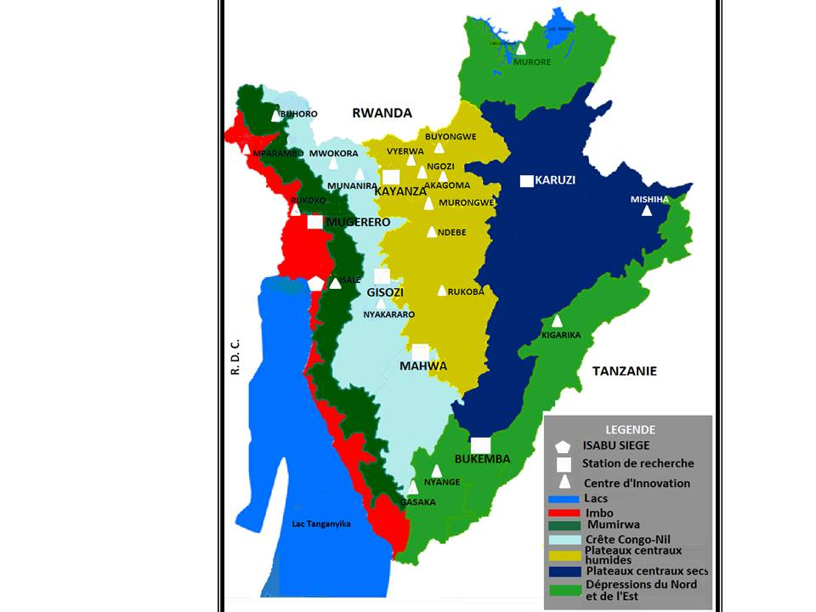
ISABU Geographic Coverage
6 regional research stations
20 Innovation Centers

Slide 6
.
Collaboration and partnerships
National
CNTA, UB/FABI, UN/FACAGRO, ONCCS, OTB, COPROSEBU, FERMIERS, BREEDERS, ONCCS, ODECA, SRDI, SOSUMO, COGERCO, PRODEFI, PAIOSA, AGROBIOTEC, WV, CRS, NGOs
Regional
ASARECA, FARA, PABRA, NARO, KARLO, RAB, TARI, INERA
International
CIP, CIAT, IRRI, CYMMIT, ICRISAT, ILRI, IITA, Bioversity International,
CABI-Plantwise etc.
ISABU
Main Donors
Government of Burundi, ADB, WB, EU, IFAD, SDC, BADEA

Slide 7
Area of intervention
1. Food crops and oilseeds
2. Industrial crops for export
3. Horticulture
4. Indigenous and medicinal cultures
5. Improvement of livestock performance (breeding)
6. Agricultural and livestock products promotion
7. Agrarian systems and rural economy
8. Agriculture and environment
9. Laboratories
10. Prebase seeds
11. Scientific documentation and communication
12. Biometrics and Computing
13. Training and Service

Slide 8
Opportunities for Agricultural Research in Burundi
Burundi's partnership agreements with research organizations at the National, regional and international levels;
The existence of the National Development Plan (NDP/PND) of Burundi [2018-2027], strategies and sector policies favorable for agricultural research;
The existence of an Agricultural Research Master Plan (ARMP/PDRA) Strategic vision 2021-2030
The manifest desire of the Government of Burundi to make science, technology and research a tool for sustainable development;

Slide 9
Constraints/challenges of agricultural research in Burundi
Low level of investment and funding for research;
Less adapted infrastructure and equipment;
Low capacity in human resources (researchers) having acquired in-depth knowledge in their fields of expertise.
Lack of a body for guidance, regulation and coordination of agricultural research institutes and centers in Burundi (Each center works for itself).

Slide 10
Constraints/challenges of agricultural research in Burundi
5. Low level of understanding of the concept of "research" by policy makers,
6. An imbalance in salaries between research institutions which often leads to the instability of human resources,
7. Low scientific diversity: Several areas of research do not have specialist researchers. (Livestock, industrial crops, horticulture, laboratories, Processing etc.).
8. Lack of control of climate change (irrigation system, greenhouse agriculture, food conservation, etc.)

Slide 11
What to do
Establish a national strategy for training and rational management of human resources by priority area (UNIVERSITY)
Review financial system by priority (GOVERNMENT)
Put in place strategies to circumvent climate change (ALL)
Identify priority research areas (RESEARCH INSTITUTES)
Evolve towards market agriculture (mindset change )

