Slide 1




African Digital Agriculture Programme (AfriDAP)
Data Science for Agriculture consultative forum
Marrakesh, Morocco 20-22 March 2019
Prof Muliaro Wafula
Director, ICT Centre of Excellence andOpen Data
JKUAT-Kenya

Slide 2
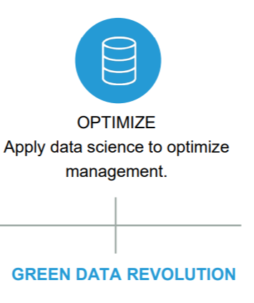
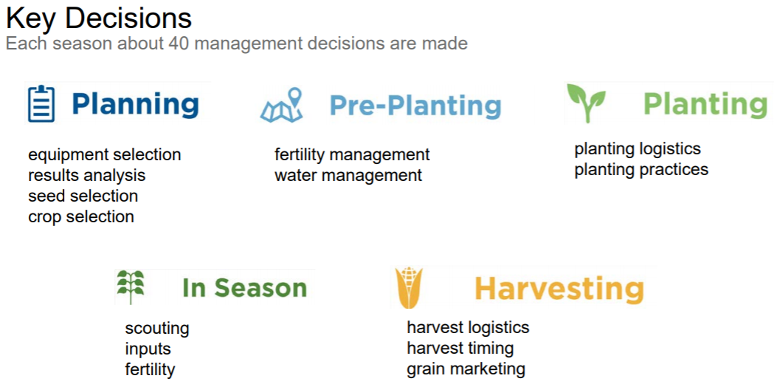
Data Science for Agriculture
Source: http://researchpark.illinois.edu/sites/researchpark.illinois.edu/files/Moorea%20Brega%20Slides.pdf

Slide 3
Multiple Parameters to Manage
Environment, Practices
Soil, Water, People,
Nutrient, Finance,
Genetics,
Crop/Animal
Production
Role of Data Science
  Process ALL data and enable Insights and Informed Decisions

Slide 4
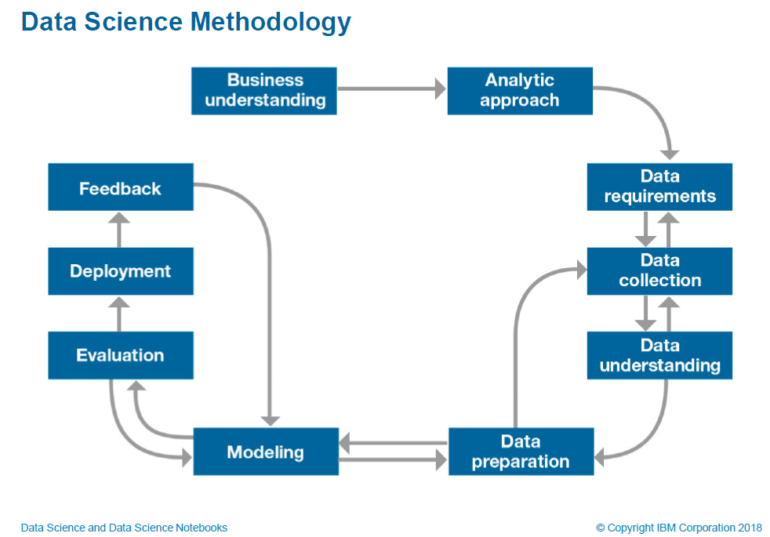

Slide 5
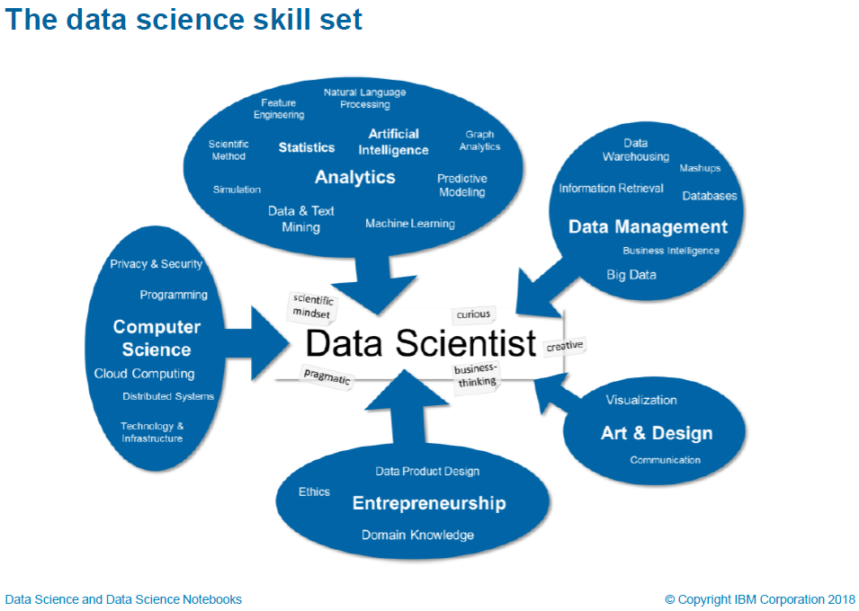

Slide 6
African Open Science Platform-AOSP
(http://africanopenscience.org.za/)
Strand 1: Provision of cloud computing facilities that provide networked computation, data access and analysis tools for African Science.
Strand 2: Provision of software tools, experience-based advice on research data management and on open science policies and practice.
Strand 3: Create and sustain high level, internationally competitive research capacity in data analytics and artificial intelligence in support of platform science priorities. (Create an African Artificial Intelligence and Data Science Institute)
Strand 4: Programmes of data-intensive research that place African scientists at the international forefront in the application of data technologies to major research domains, as a fundamental resource for a modern society
Strand 5: Create understanding, awareness and capacity in citizens and professionals in dealing with a data- and information-intensive world.
Strand 6: Develop a community where access to data, information and scientific expertise is enabled and where scientists are engaged that jointly frame and jointly seek solutions to significant problems. in cross-societal collaborations

Slide 7
Open Science Policy for Agriculture
Challenges
Formulate Policy Statements
No established best open science practices in Agricuture
Competition among scientists
Existing credit systems favour closed science
Non-disclosure agreements
Copyright laws and intellectual property guidelines
Open Science in Agriculture policy to create enabling environment to address mainly:
open access, open data, open research data, Findable, Available Interoperable and Reusable (FAIR) data and Just data.
Infrastructure
Funders, Publishers, citizens, government, researchers, Institutions
Source: The African Open Science Policy Framework (Wafula, JM et al ) in press

Slide 8
Enabling Env. For Open Science Policy for Agriculture
Enablers for Open Science Policy for Agri include:
  Culture
  Citizen Science
  Cloud computing
  Science diplomacy etc

Slide 9
GO-FAIR-IN-Africa
Why?
Linking African Universities
conforming toFAIR-principles inorder to harness
governance of data created in Africa
Africa owning its data
position Africa in global connected world.
chance for promoting data science for economic potential, education and training in Africa

Slide 10
GO-FAIR-IN-Africa Benefits
bring together African expertise, from within the African continent in all its diversity, and in the diaspora, in collaboration with colleagues from other parts of the world, with the explicit objective to strengthen the lead African scholars, decision-makers and practitioners in the global network of implementation for an internet of FAIR data and services on the African continent
The IN-Africa empowers African citizens, governments, public and private organizations to manage, safeguard, and share their data for use in scientific research and services.

Slide 11
Thank you!

